Slide 1
Policy & Ethics for Experiments
Even before starting an experiment one should think about privacy of participant’s and follow ethical rules while testing

Slide 2
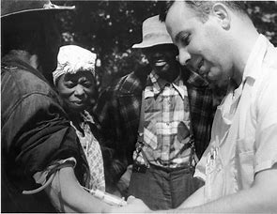

Tuskegee Experiment
US health department ran a testing of Syphilis on African-American people under the tag of providing free healthcare.
This horrible example shows first time in history, 'how important is that to protect participant while any experiment?’

Slide 3
Four Main Principles that need to be considered
Benefits:
What benefits might be outcome of experiments
Risk
What risk participants being exposed to
Choice:
What other choice do participants have
Privacy:
What expectation of privacy do participants have

Slide 4
Choosing & Characterizing metrics

Slide 5
Metric Choice
Invariant Checking
Evaluation
These are generally for the purpose of sanity checking e.g. count
Following questions can be answered by these metrics
Do you have the same number of users across the two?
Is the distribution the same?
High level business metrics: how much revenue you make, what your market share is, how many users you have
Sometimes we don’t have that much data to compute business metrics e.g. How many student got job after this course
Detailed metrics: user experience with the product
Example- to check user experience on any site we consider ctr , impressions etc.
The detailed metrics are the one that we mostly use

Slide 6
Some of the commonly use metrics
Bounce Rate : The percentage of visitors to a particular website who navigate away from the site after viewing only one page.
Conversion rate : The point at which an activity or response to a call to action fulfills the desired outcome (i.e. subscribing to a newsletter or purchasing a product) to the total visitors visited
Clickthrough rate : The ratio of total number of visitors clicks and total number of people visited
Clickthrough Probability : The ratio of unique clicks to the unique visitors visited
To check out other metrics in details (ctrl+ click to see blog): The Full Glossary of Web Analytics Terms You Should Know - Alexa Blog
14 Important Website Performance Metrics You Should Be Analyzing - KeyCDN

Slide 7
High Level Metric:
This is a metric which summarizes your intention about results
Examples-
1.Clickthrough Probability
2.Clickthrough Rate
3.Active Users
Detailed Metric:
This is a stage where we design a well defined metric
Example-
For active users which time frame are you considering?
7 day activation?
30 day activation?
Summarizing:
This is stage where we summarize detailed metric to give us high level metric
Taking count , average, sum of secondary level metrics

Slide 8
High Level Metrics : Customer Funnel
Example – PayPal company
Business Objective – Increasing customer & merchant accounts

Slide 9
Users landing on a Homepage
Users starting signup process
Users completing signups
Account activation in 7days
Trans-
actions

Slide 10
Refining the customer funnel
User funnel indicates a series of steps taken by users through the site. It is called a funnel because every subsequent stage has fewer users than the stage above.
Each stage is a metric:
Count: No. of users who reach that point (keep in certain stages)
Rate: better for usability test. You want to increase rate of progression
Probability: progression. A unique user progressed down the funnel

Slide 11
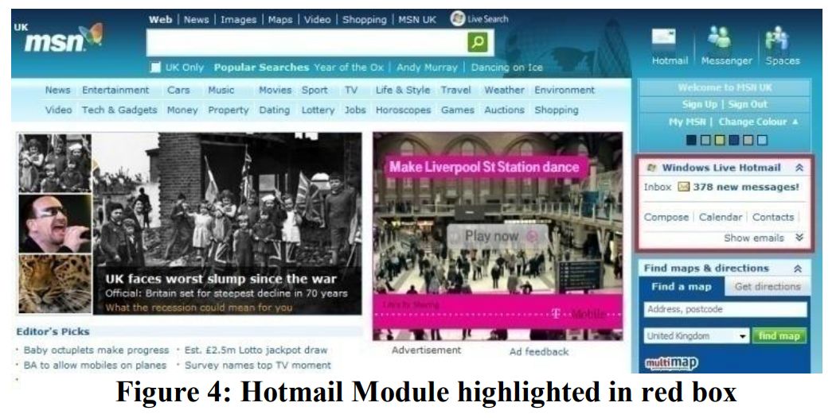
Conversion of high level metric to detailed metric
Let’s say for this page you defined a
your high level metric is ctp
CTP = Unique users click/ Unique visitors
This is not explaining in detail like are you
considering those visitors on daily basis,
Weekly basis etc

Slide 12

Definition 1- Cookie Probability
Considering cookie as a visitor
For each (time interval)= cookies that click/cookies visit
5 min 30 sec 12 hr
Click No click Click No click
A user enters click on page, for 5 min he didn’t click but after 30 sec he click and after
12 hr he logins again but didn’t click
Per 1 min ctp =2/3 per hr ctp = ½ per day ctp =1

Slide 13
Definition 2 – Pageview Probability
CTP = Unique pageview id who click/ total unique pageview id
30 sec 1 sec
pageview Reloads pageview click
Ctp per 1 min = ½
Question ctp per min (from def 1) = ?
The keynote we can take from here is no matter which definition you choose it will get
affected

Slide 14
Which metrics will be affected?
Cause
Cookie probability
Pageview probability
Users double click
Reload button caches page
Click tracking bug

Slide 15
Difficult metrices to calculate
Conversion rate on real estate site from referrals
People don’t usually buy houses
Students getting job after completing course on site
Don’t have access to data
Average happiness of shoppers
Don’t have access to data
Probability of finding results via search
Don’t have access to data
Takes too long to collect data
Other factors might influence the data
We may count hoe many users are clicking on search but whether they are finding desired result is difficult to count

Slide 16
Other Techniques to gather data
External Data:
Great for brainstorming, think of new metrics idea; good for validating metrics; benchmark your own metrics against the industry; help you develop validation techniques
Companies that collect data (e.g. Comscore, Nielsen)
Companies that conduct surveys (e.g. Pew)
Academic papers
Internal Data:
Retrospective analysis:
Look at historic data to look at changes and see the evaluation
Good to get a baseline and help you develop theories
Surveys and User experience research:
help you develop ideas on what you want to research

Slide 17
Filtering & Segmenting
You may have to filter out spam and fraud to de-bias the data. You do want to be careful you don't introduce bias into your data by doing the filtering.
One way to figure out if you are biasing or de-biasing the data by filtering, is to slice your data by country, or by language, or by platform, and then calculate the metric for each slice after filtering. If you are affecting any slide disproportionately, then you may be biasing your data with filtering
Question: What if the data is already disproportionate, how will you decide whether it’s a spam or original data? Example- Pubg app performing in Asia but not in USA
Answer : To solve this we can plot data on weekly , monthly or yearly basis or even look into the historic data. If we find some abnormal spikes, we can conclude that it is due to spam or fraud

Slide 18
AN unusual spike in graph
We can see a smoothly variation but weird spike is still there
Even in yearly graph we can see it, Now we are sure it’s a spam
If we look data country wise, now we can see one country causing spams

Slide 19
Suspect Click tracking issue : Clicks counted twice on mobile Which graphs would confirm this issue?
CTP over time
CTR over time
Both CTR and CTP over same graph
CTR by platform
Both CTR and CTP by platform
CTP by platform

Slide 20
CTR will not be helpful
CTR and CTP naturally follow this trend, so not helpful
CTP over time will not be helpful
CTR by platform looks quite suspicious but desktop and mobile may have variations
CTP by platform will not be helpful

Slide 21
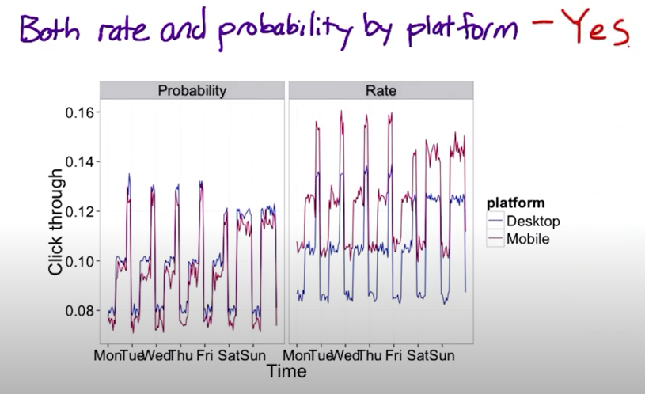
Both CTR and CTP by platform on same graph clearly shows there’s something wrong with CTR
We will not be able to define specifically that clicks are not working properly but we could discuss with engineering team that there’s an error in instrumentation

Slide 22
Summary Metrics
Summarize all of these individual data measurements into a single summery metric

Slide 23
Categories of summary metrics
Sums & Counts
Summation and count of total users visited
Probabilities & rates
CTP & CTR
Ratios
Distributional Metrics
can compute a whole range of different business models, and various different things that you may care about, but they can be very difficult to characterize.
the means, the medians, the 25th, the 75th and 90th percentiles.

Slide 24
Example of distributional Metric
Day | User id | Video Watch Time
1 | A12 | 12
2 | A12 | 42
2 | D32 | 534
2 | D65 | 13
3 | A34 | 45
3 | V53 | 213
4 | C32 | 35
5 | C32 | 31
5 | B42 | 63
As we can see the metric itself are individual numbers, so here distributions are useful

Slide 25
Characteristic for your metric
Sensitivity & Robustness
Distribution
You want your metric to be sensitive enough, in order to actually detect a change when you, when you're testing your possible future options
The most ideal way of doing this is to do a retrospective analysis to compute a histogram.

Slide 26
Sensitivity & Robustness
Whether the metric is sensitive to changes you care about, and is robust to changes you don’t care about
mean is sensitive to outliers - NOT robust
median is robust but not sensitive to changes to small group of users
How to measure Sensitivity and Robustness:
A/A tests to see if the metric picks up any spurious differences
Using prior experiments to see if the metric moves in a way that intuitively make sense.
Retrospective analysis of log data: look back at changes you made to your website and see if the metrics you're interested in actually moved in conjunction with chose changes.

